Slide 1

UNIVERSITY INSTITUTE OF SCIENCES
Academic Unit I
Bachelor of Engineering (Computer Science & Engineering)
Biology For Engineers 23SZ148
INTRODUCTION
Measurement system
DISCOVER . LEARN . EMPOWER

Slide 2
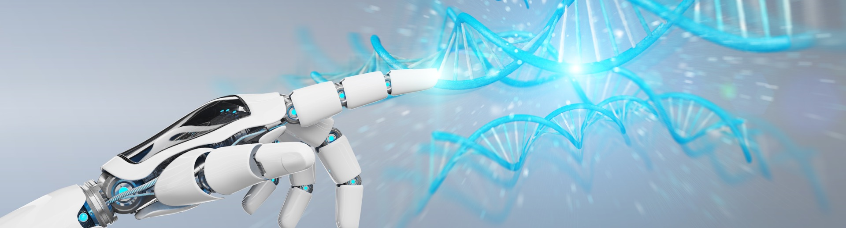
INTRODUCTION
Course Objective
This subject is designed to impart fundamental knowledge on basic of genetics and emerging fields of biology like biomedical recording system and medical instrumentation.
It is designed to impart knowledge that how to apply basics of biology in engineering.
https://www.uic.es/sites/default/files/uic-grau-bioenginyeria-hero-header_1.jpg

Slide 3

INTRODUCTION
Space for visual (size 24)
Course Outcome
CO Number | Title | Level
CO1 | Identify the biological concepts from an engineering perspective. | knowledge
CO2 | Development of artificial systems mimicking human action. | Understand
CO3 | Explain the basic of genetics that helps to identify and formulate problems | Analyze
CO4 | Apply knowledge of measurement system, biomedical recording system and biosensors to excel in areas such as entrepreneurship, medicine, government, and education. | Apply
CO5 | Integrate biological principles for developing next generation technologies, | Create
Will be covered in this lecture
https://specials-images.forbesimg.com/imageserve/1034901762/960x0.jpg?fit=scale

Slide 4
SYLLABUS
Unit-2 | Biosensors and measurement system | Contact Hours: 15
Chapter 1 Medical Instrumentation Chapter 2 Measurement System Chapter 3 Biological Sensor | Medical Instrumentation: Sources of biomedical Signals, Basic medical Instrumentation system, Performance requirements of medical Instrumentation System, Microprocessors in Medical instruments, PC base medical Instruments, General constraints in the design of medical Instrumentation system, Regulation of Medical Devices. Measurement System: Specification of instruments, Statics & Dynamic characteristics of medical instruments, Classification of errors. Statistical analysis, Reliability, Accuracy, Fidelity, Speed of responses, Linearization of technique, and Data Acquisition System. Biological sensors: Sensors/ receptors in the human body, basic organization of the nervous system- neural mechanism, Chemoreceptor: hot and cold receptors, sensors for smell, sound, vision, Ion exchange membrane electrodes, enzyme, glucose sensors, immunosensors, & biosensors & applications of biosensors.

Slide 5
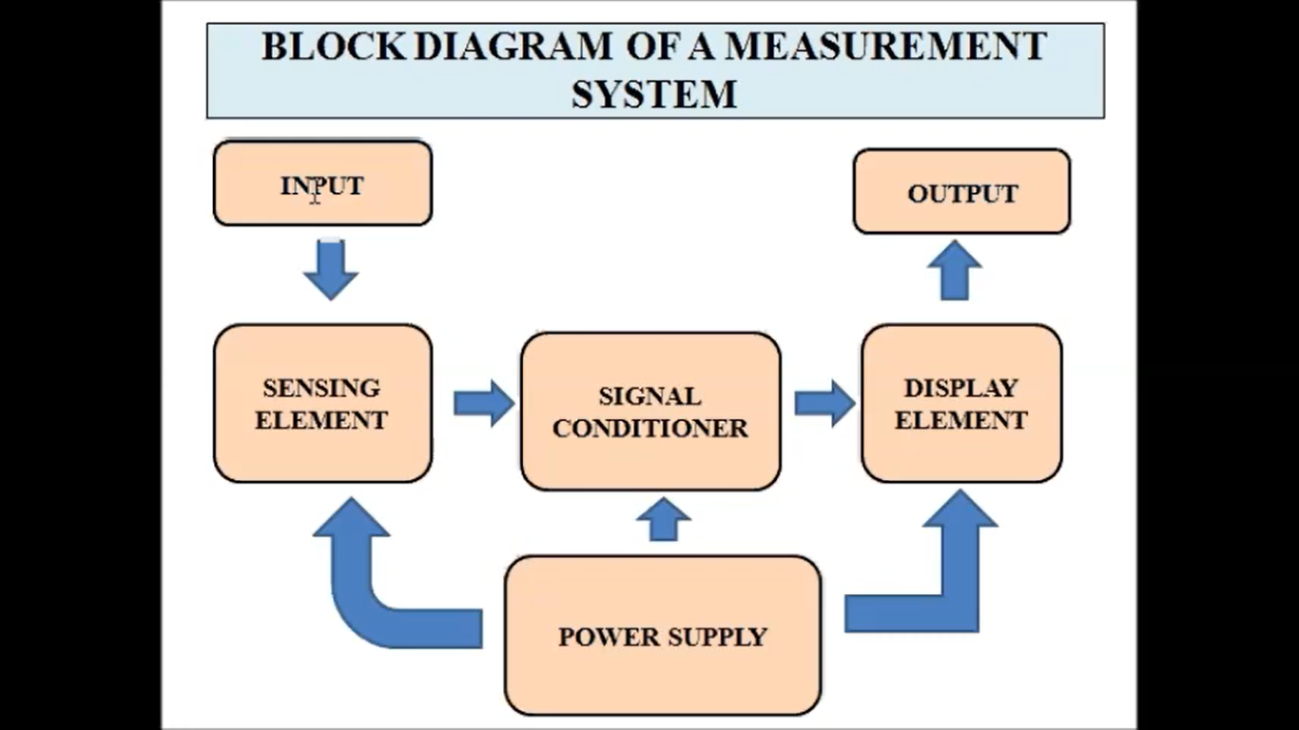
Measurement system

Slide 6
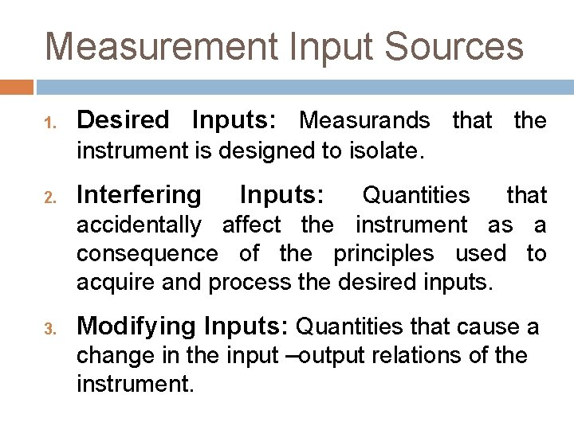
Types of inputs in measurement system

Slide 7
Specification of Instruments
Instrument performance is specified by range, resolution, accuracy, and precision.
Range is defined by the highest and lowest readings the instrument is expected to produce.
Sensitivity is the smallest change that can be sensed by a sensor. Sensitivity typically decreases as range increases.
Resolution is the smallest change that can be displayed on a readout device. Resolution typically decreases as range increases.

Slide 8
Repeatability or Precision is the degree to which a reading deviates from the mean of a series of readings taken under identical conditions.
Accuracy is the degree to which a reading deviates from an absolute value.

Slide 9
Classification of Errors
Systematic errors
Random errors
Gross errors (Blunders)

Slide 10
Systematic errors
Errors caused by experiments procedure.
These are errors caused by the way in which the experiment was conducted. In other words, they are caused by the design of the system.
Poor procedure, or poor execution leads to more errors.
Systemic error can be removed by replacing the instruments.

Slide 11
Random errors
These errors are unpredictable.
Observational:
For example, errors in judgment of an observer when reading the scale of a measuring device to the smallest division.
Environmental:
For example, unpredictable fluctuations in line voltage, temperature, or mechanical vibrations of equipment.

Slide 12
Gross Errors (Blunders)
A final source of error, called a blunder or gross error, is an outright mistake.
These errors occur due to carelessness or lack of experience of a human
A person may record a wrong value, misread a scale, forget a digit when reading a scale or recording a measurement, or make a similar blunder.
Gross error is caused by careless handling.

Slide 13
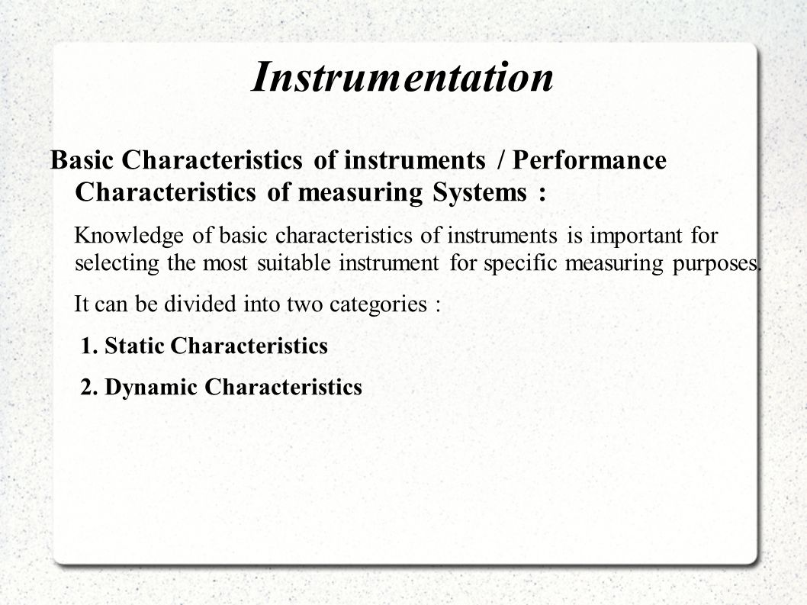
Basic Characteristics of Instruments
https://image.slidesharecdn.com/myppt2-140916110617-phpapp02/95/the-laws-of-mendel-9-638.jpg?cb=1410865730

Slide 14
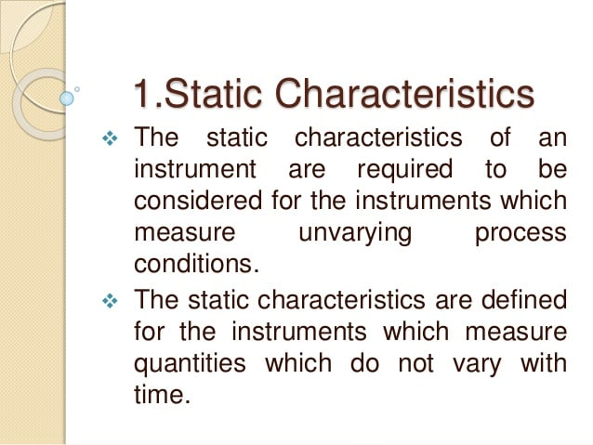
Static Characteristics
https://image.slidesharecdn.com/myppt2-140916110617-phpapp02/95/the-laws-of-mendel-9-638.jpg?cb=1410865730

Slide 15
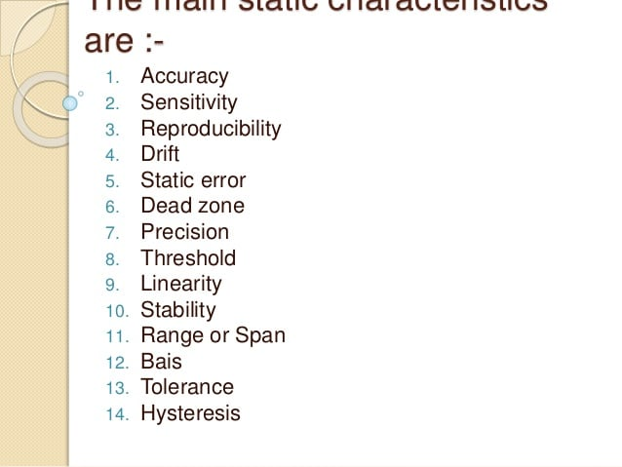
Static Characteristics
https://image.slidesharecdn.com/myppt2-140916110617-phpapp02/95/the-laws-of-mendel-9-638.jpg?cb=1410865730

Slide 16
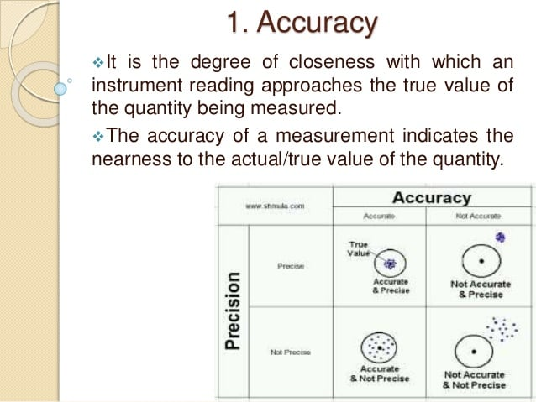
https://www.thesciencenotes.com/wp-content/uploads/2020/11/333.gif

Slide 17
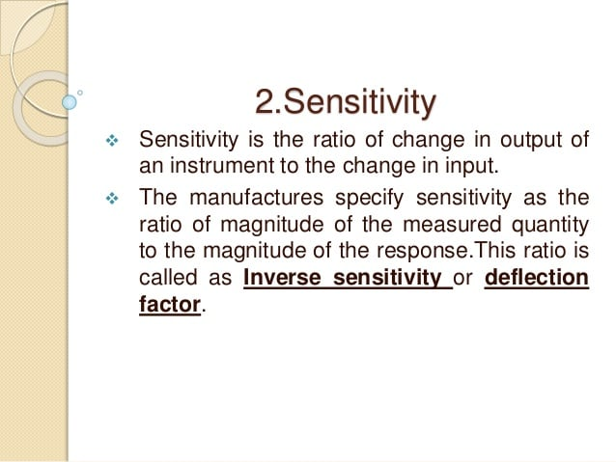
https://www.thesciencenotes.com/wp-content/uploads/2020/11/333.gif

Slide 18
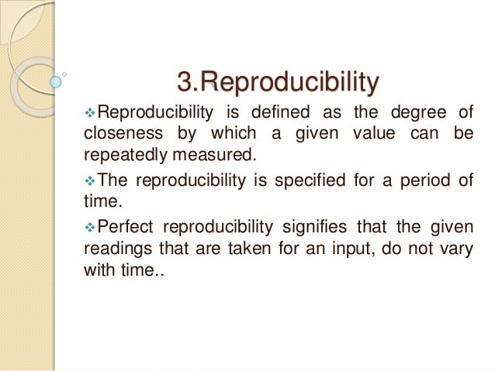
https://www.thesciencenotes.com/wp-content/uploads/2020/11/333.gif

Slide 19
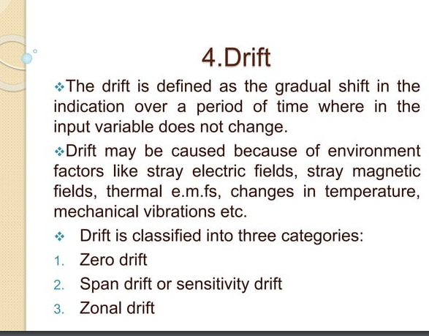

Slide 20
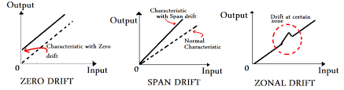

Slide 21
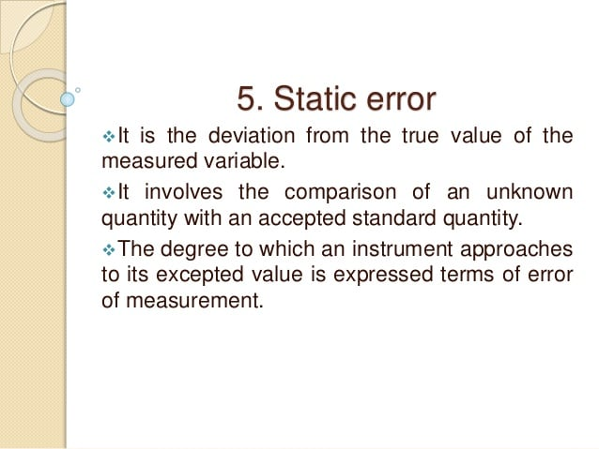
https://www.thesciencenotes.com/wp-content/uploads/2020/11/333.gif

Slide 22
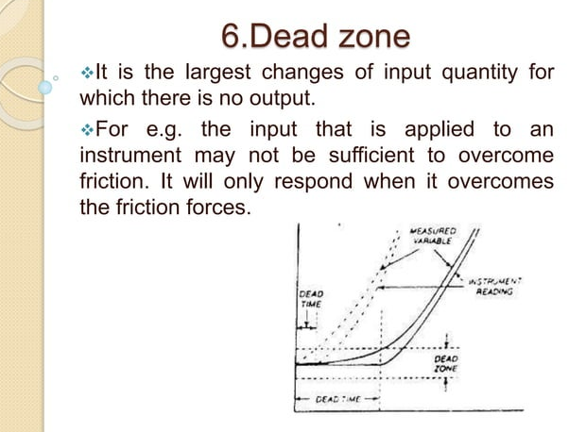

Slide 23
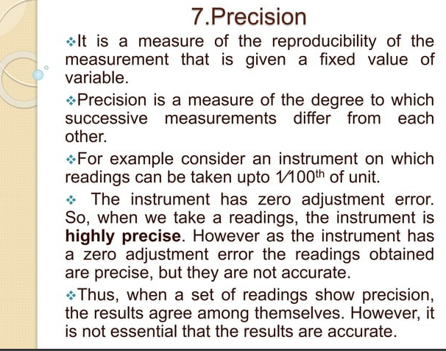

Slide 24
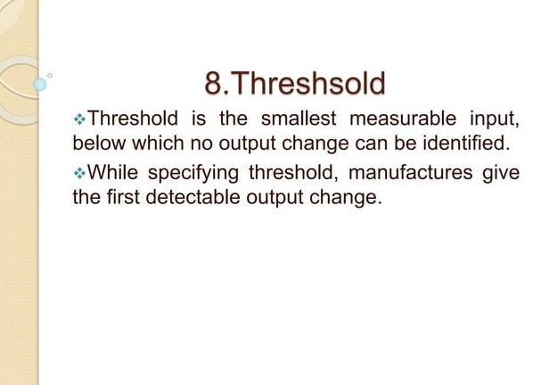

Slide 25
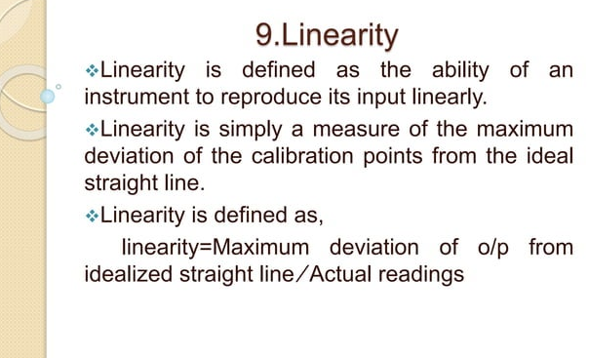

Slide 26
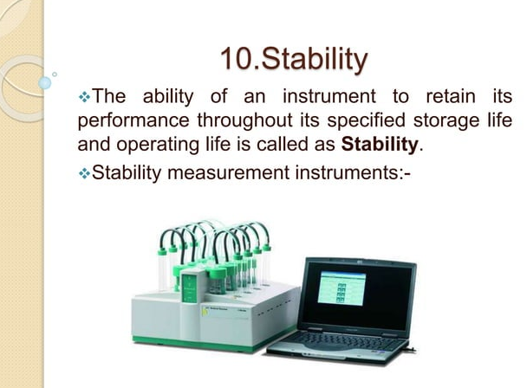

Slide 27
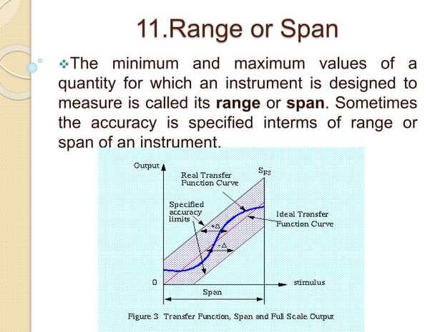

Slide 28
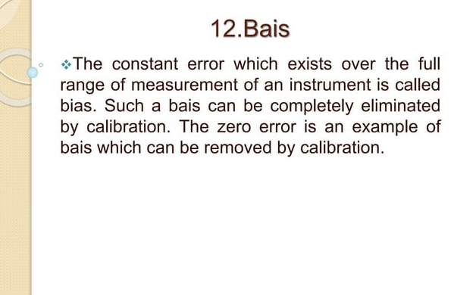
Bias

Slide 29
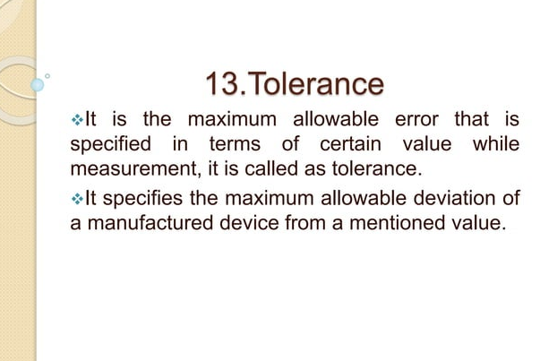

Slide 30
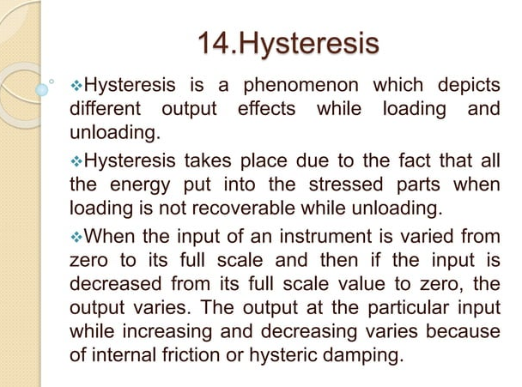

Slide 31
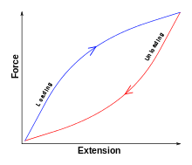

Slide 32
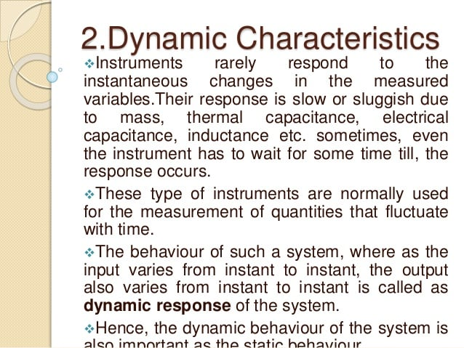
Dynamic Characteristics
https://www.thesciencenotes.com/wp-content/uploads/2020/11/333.gif

Slide 33
Dynamic characteristics
Dynamic characteristics refer to the performance of the instrument when the input variable is changing rapidly with time.
For example, human eye cannot detect any event whose duration is less than one-tenth of a second; thus the dynamic performance of human eye cannot be said to be very satisfactory.

Slide 34
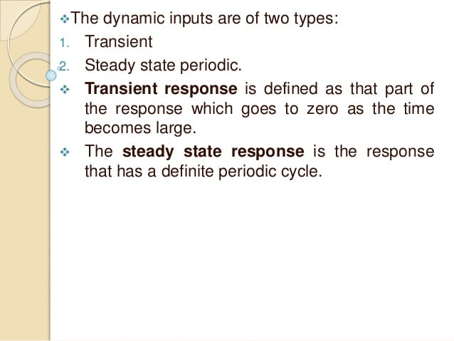
Dynamic Characteristics
https://www.thesciencenotes.com/wp-content/uploads/2020/11/333.gif

Slide 35
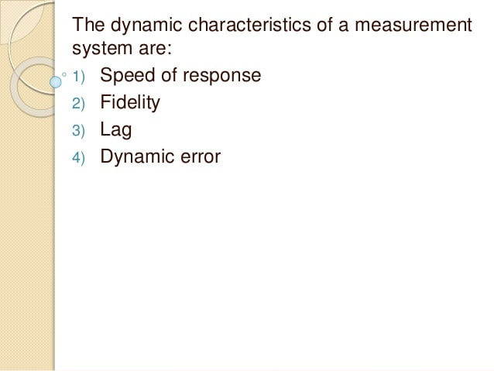
Dynamic Characteristics
https://www.thesciencenotes.com/wp-content/uploads/2020/11/333.gif

Slide 36
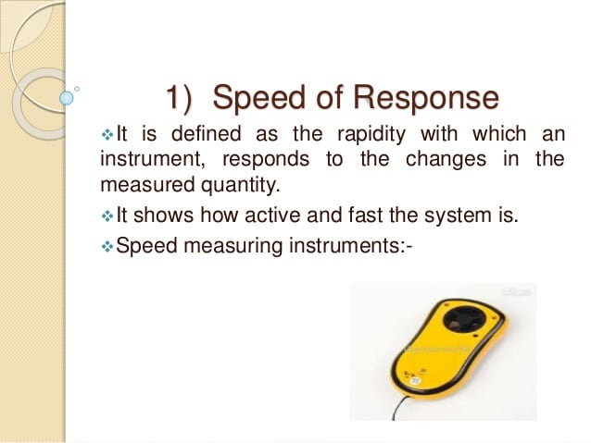
Dynamic Characteristics
https://www.thesciencenotes.com/wp-content/uploads/2020/11/333.gif

Slide 37
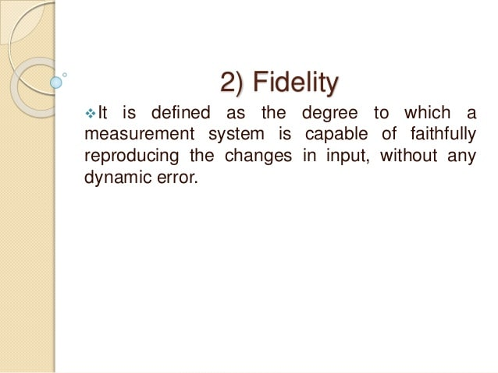
Dynamic Characteristics
https://www.thesciencenotes.com/wp-content/uploads/2020/11/333.gif

Slide 38
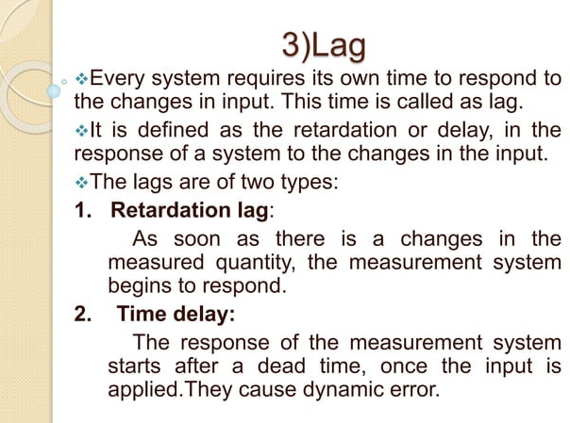

Slide 39
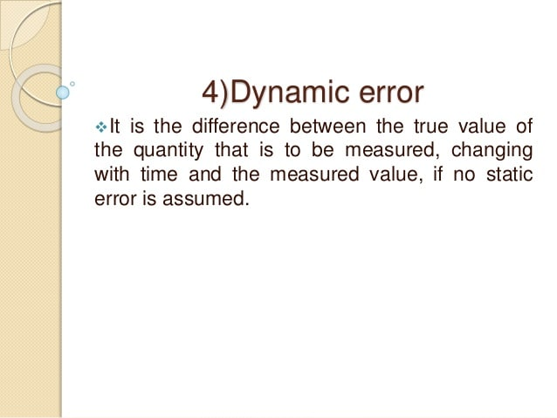
Dynamic Characteristics
https://www.thesciencenotes.com/wp-content/uploads/2020/11/333.gif

Slide 40
REFERENCES
C. R. Balamurugan and D. Periazhaagar Basics of Biomedical Instrumentation. Magnus Publications, Chennai ISBN: 978-81-939626-7-1
Gupta, P.K.. Cytology, Genetics and Molecular Biology, Rastogi Publishers, Meerut, 1993.
Roit I.M., Brostoff J. and Male D. Mosby .Immunology (6 th Edition) by, An imprint of Elsevier Sci Ltd., 2002.
G. Webster , Medical Instrumentation: Application And Design, 3rd edition ,Wiley Publishers
D Reddy, Biomedical Signal Processing, Tata Mcgraw Hill Publications.
Sergio Cerutti Advanced Methods of Biomedical Signal Processing, Oxford Publications.
B. Jacobson, J.G. Webster, Medical and Clinical Engineering, Prentice Hall, International.
Cromwell, Biomedical Instrumentation and Measurements, Prentice Hall, International.
R.S. Khandupur, Handbook of Biomedical Instrumentation, - Tata McGraw Hill
Leslie Cromwell, Fred J. Weibell, Erich A. Pfeiffer, "Biomedical Instrumentation and Measurements", Pearson Education.
https://nptel.ac.in/courses/121/106/121106008/
http://mediatoget.blogspot.in/2012/01/static-dynamic-characteristicsof.htm

Slide 41
THANK YOU

